Slide 1
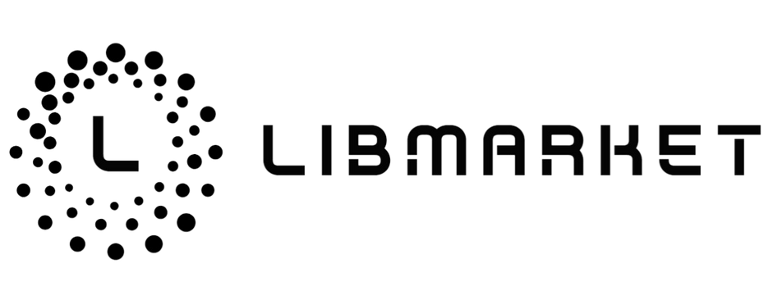
Decentralized Open Free Trade Platform
1

Slide 2
Index
01
Project Introduction
02
Current market issues
03
Development potential
04
Technical Architecture
05
Privacy and Security Protection
06
Future Plans
07
About Us
2

Slide 3
01
Project Introduction
3

Slide 4

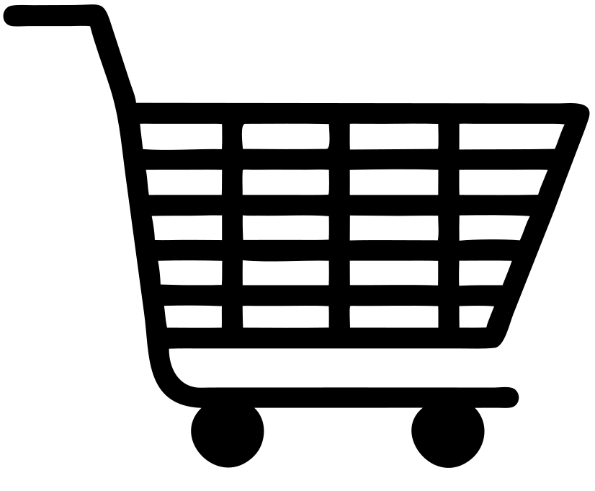

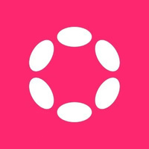
LibMarket aims to explore the possibility of decentralized e-commerce platforms, realize a Defi platform based on the C2C model for free transactions, and provide a free trading market system. Buyers and sellers can communicate directly and securely. Unlike the current traditional trading model of "sellers set prices, buyers seek to purchase NFTs", we negotiate off-chain on-chain platform guaranteed transactions for all off-chain items (including physical objects) without the need for third-party trust. This realizes a new market model where buyers and sellers can communicate and set prices..
4

Slide 5
02
Current market issues
5

Slide 6
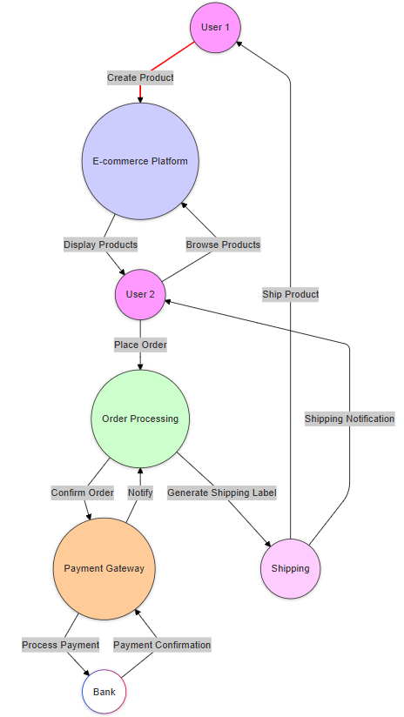
Traditional architecture
Advantages:
Community driven: Buyers and sellers establish connections through the platform, forming a good community atmosphere.
Flexibility: With third-party platform endorsement, after-sales and customer service processing.
Disadvantages:
Trust issues: Lack of trust between buyers and sellers, prone to fraud.
Difficult quality control: It is difficult for the platform to supervise the quality of all goods, affecting user experience.
Complex dispute handling: Handling sales disputes and complaints requires a lot of human resources.
6

Slide 7
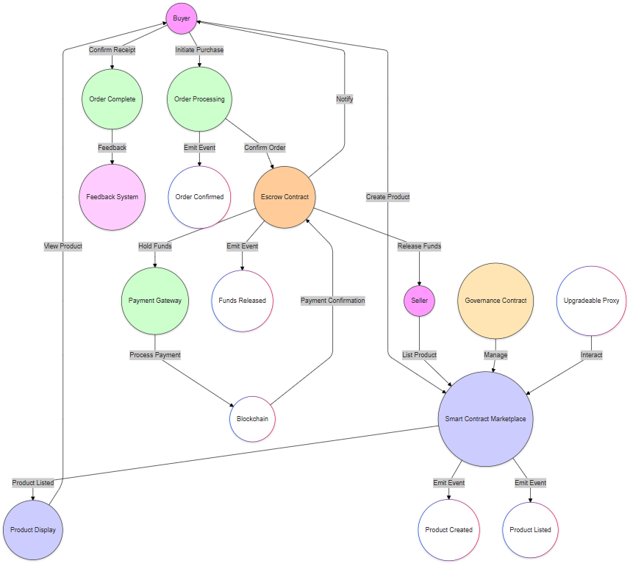
Smart Contract Model Architecture
Advantages:
Transparency: Smart contracts are open on the blockchain, all transaction records are traceable, and trust is enhanced.
Automation: Transactions and payments are automatically executed through smart contracts, reducing manual intervention and improving efficiency.
Decentralization: Without the intervention of a centralized platform, transactions between users are more direct.
Security: The use of blockchain technology reduces the risk of fraud and data tampering.
Intermediate:
Order processing: There may be a need for after-sales service, when trust mechanisms such as points can be introduced
Disadvantages:
Network congestion: When the transaction volume is high, the blockchain network may be congested, resulting in transaction delays.
7

Slide 8


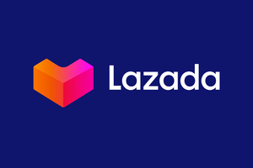

Feature category | eBay | Goofish | Lazada | LibMarket
Decentralized mechanism | ✘ | ✘ | ✘ | ✔
Product Performance | middle | middle | low | high
Privacy and Security | middle | low | middle | high
Scalable functionality | low | middle | middle | high
barrier to entry | 高 | high | high | low
Cross chain asset trading | ✘ | ✘ | ✘ | ✔
operating costs | high | middle | high | low
Trust mechanism | Relying on user feedback and platform reputation | Relying on user feedback and platform reputation | Relying on user feedback and platform reputation | Establishing trust through smart contracts and blockchain transparency
Platform control | Centralized platform management | Centralized platform management | Centralized platform management | Decentralization, user initiated transactions
transaction efficiency | More manual intervention and slower transaction speed | More manual intervention and slower transaction speed | More manual intervention and slower transaction speed | Automated execution, fast trading
Dispute resolution | Artificial intervention, handling complexity | Artificial intervention, handling complexity | Artificial intervention, handling complexity | Smart contract automatic execution reduces disputes
8

Slide 9
03
Development potential
9

Slide 10
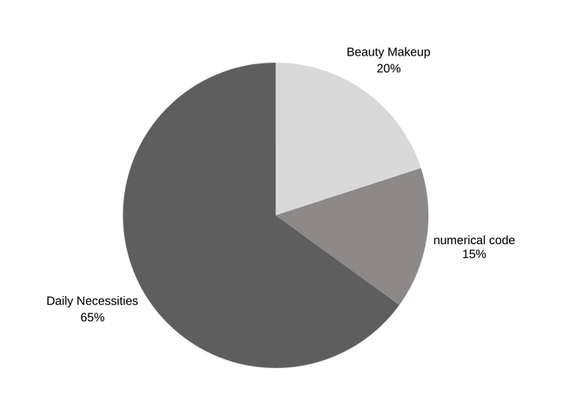
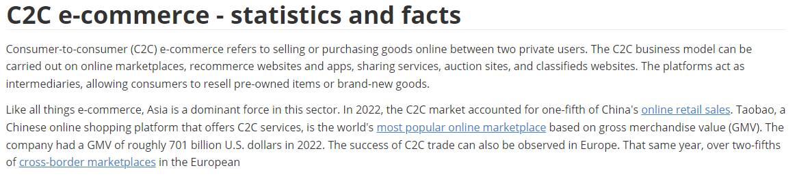
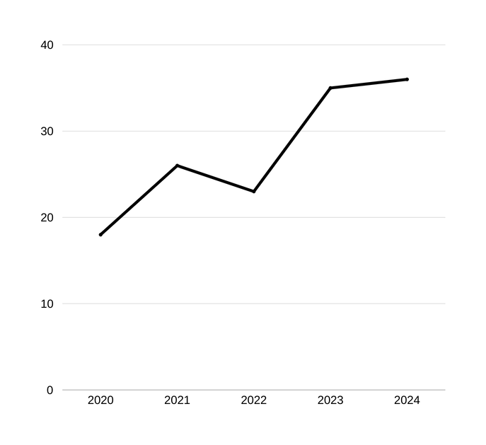
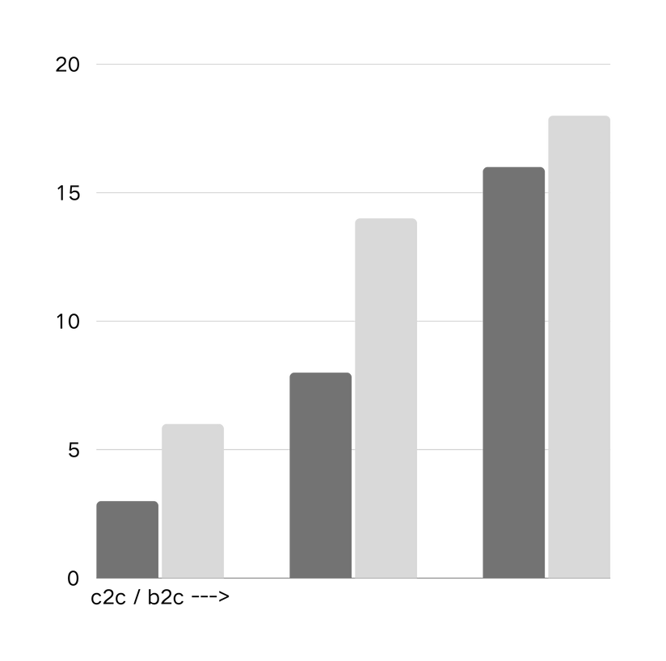
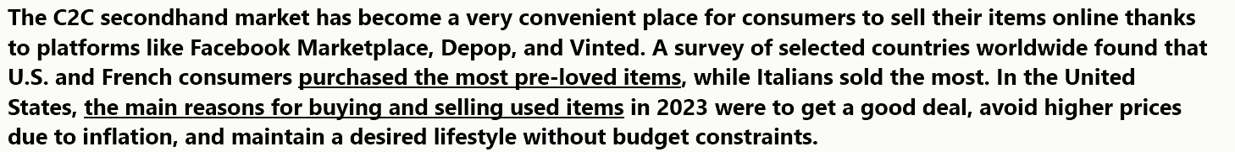
Traditional C2C market situation
10

Slide 11
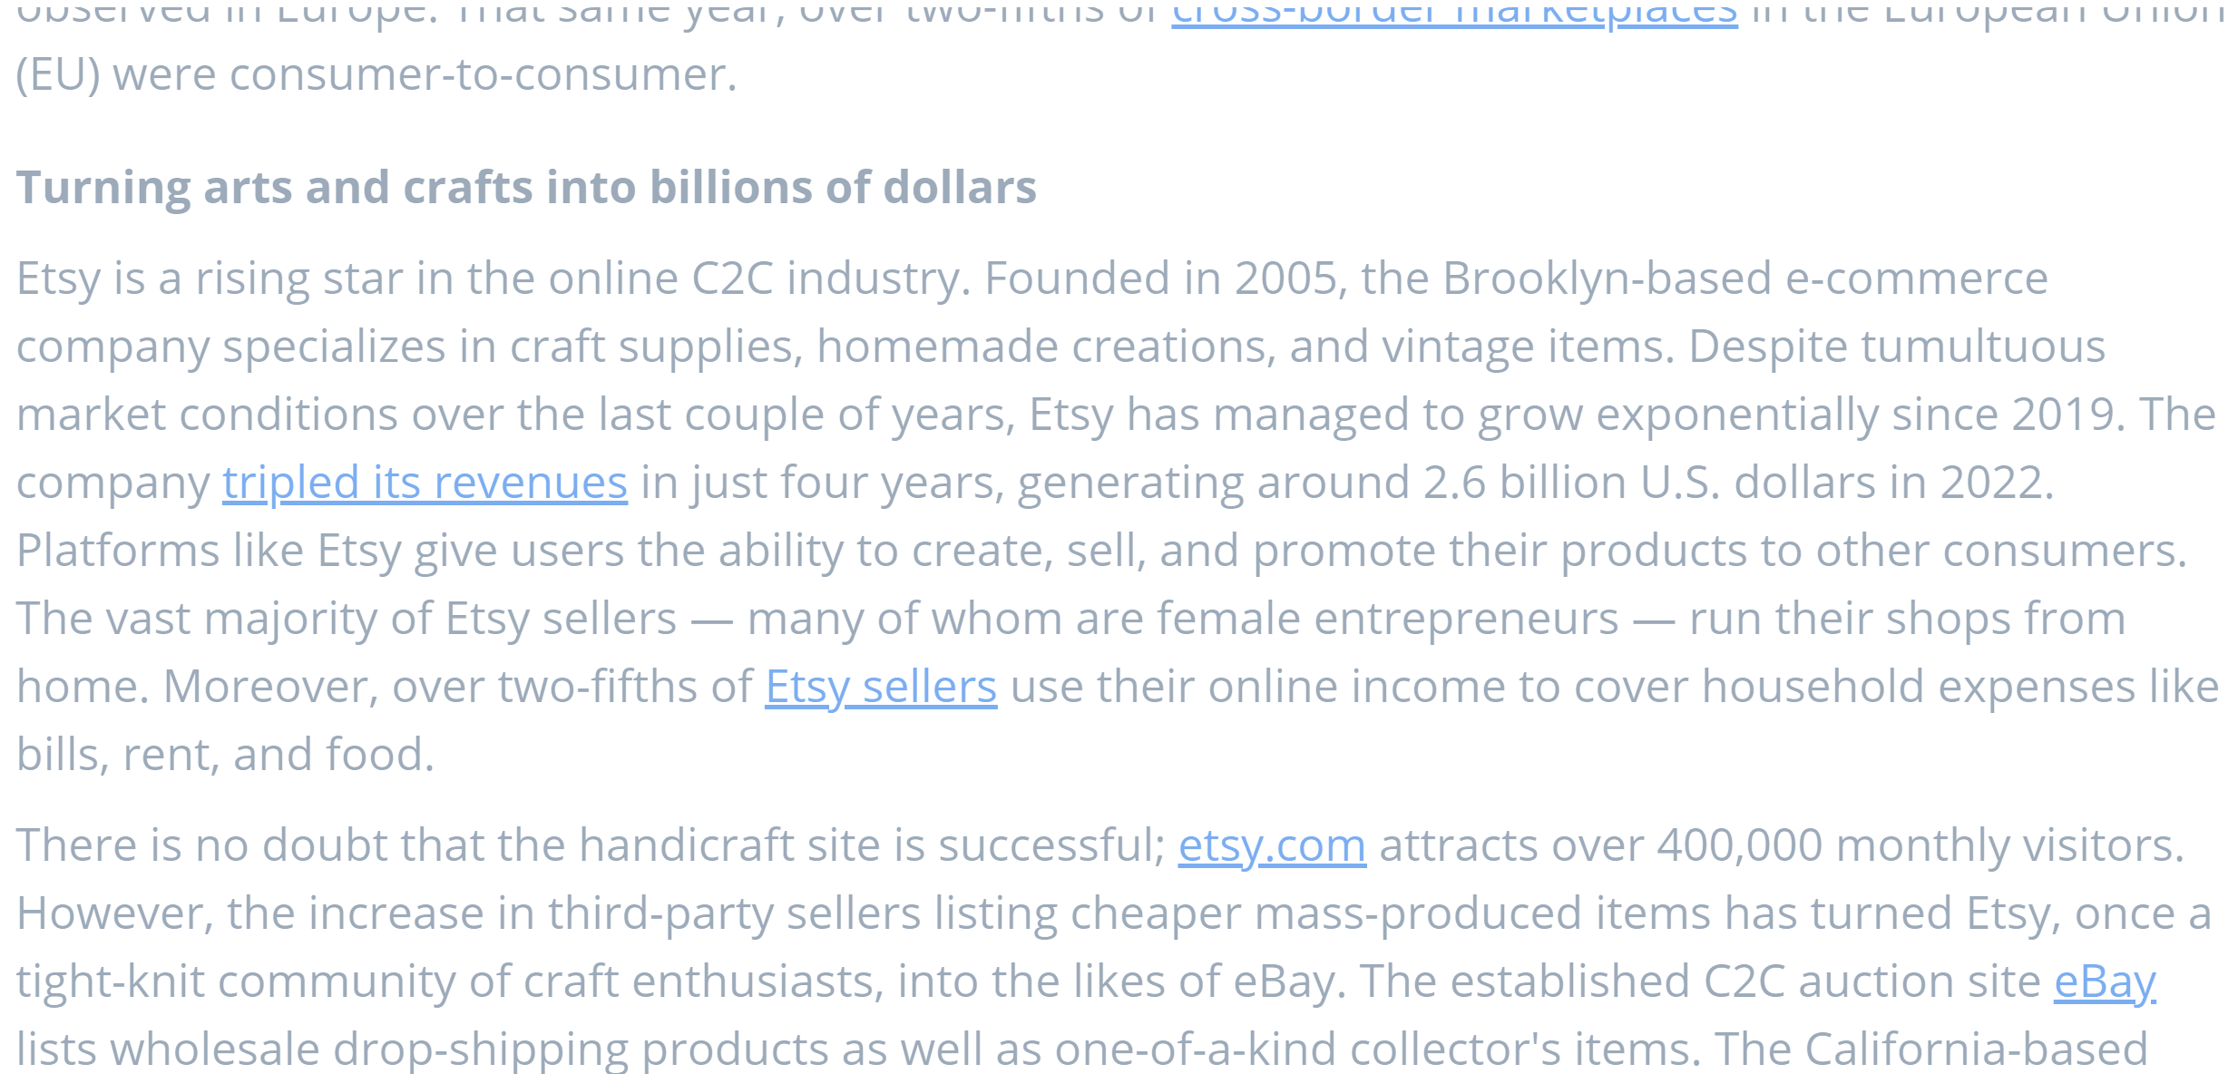



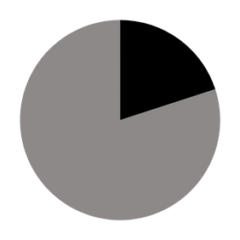


Web3 c2c model open trade platform potential
3%
30 B
+
Enhance transparency
User Scale
3 billion+
Annual growth rate 3%
Ecological Effect
Amazon + eBay
The entire market share exceeds 60%
Reduce transaction costs
Head Effect
Improve accessibility of financial services
11

Slide 12
04
Technical Architecture
12

Slide 13

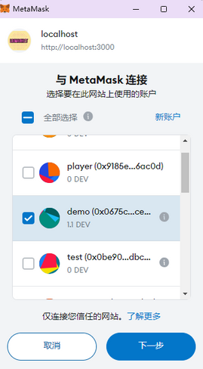
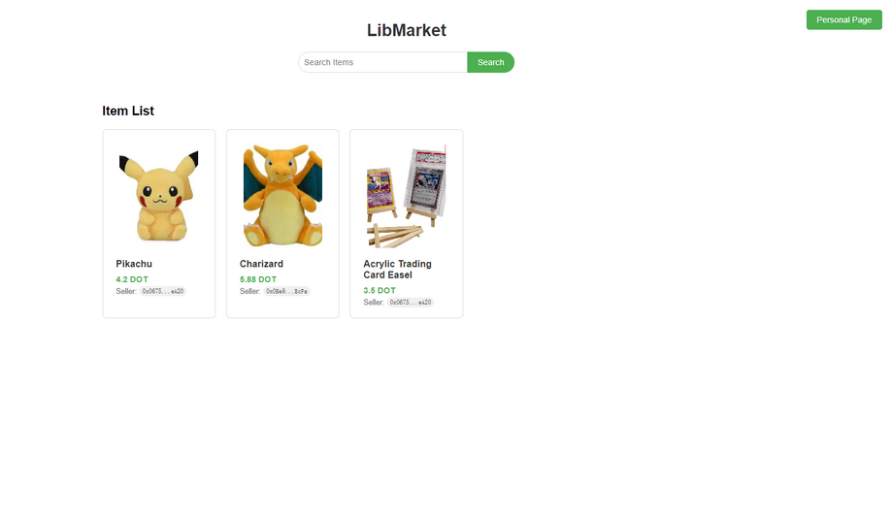
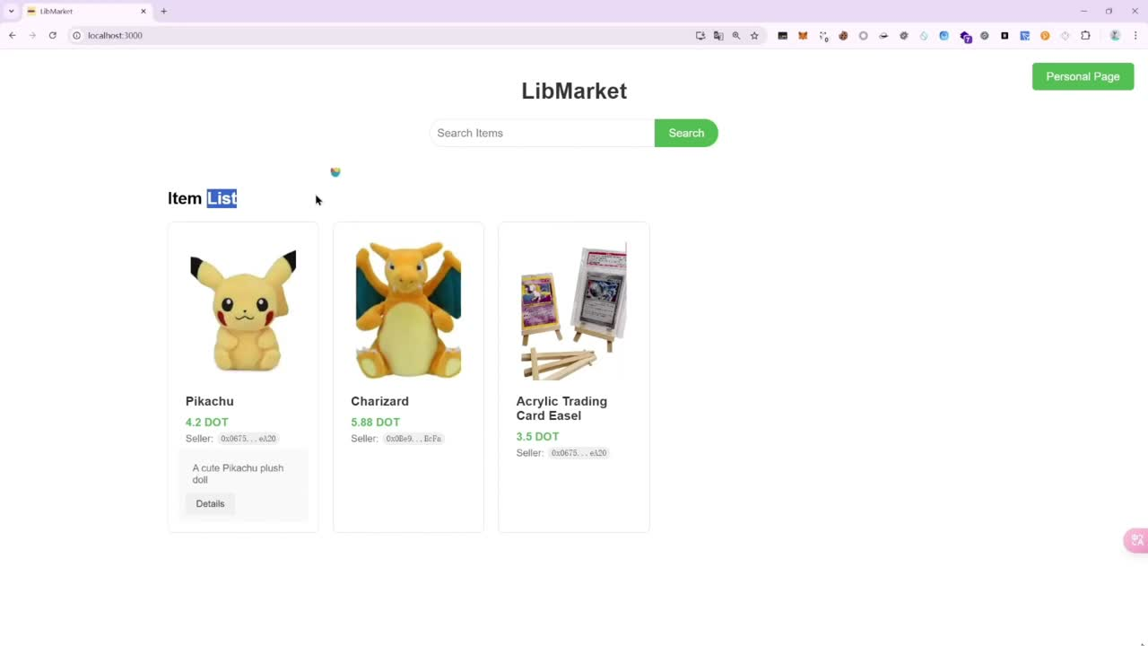

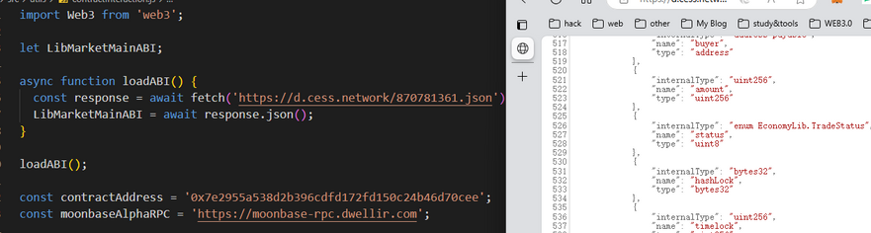

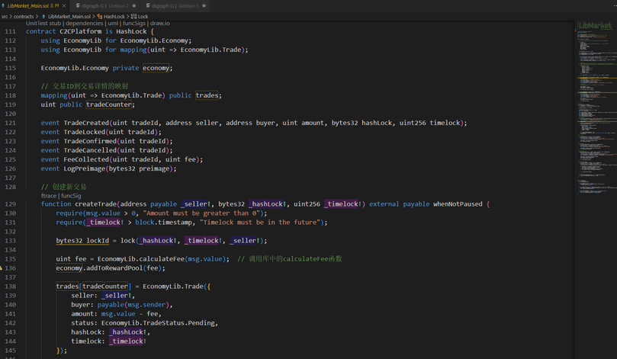
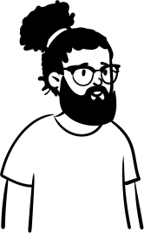
Front-end and back-end interaction architecture
13

Slide 14

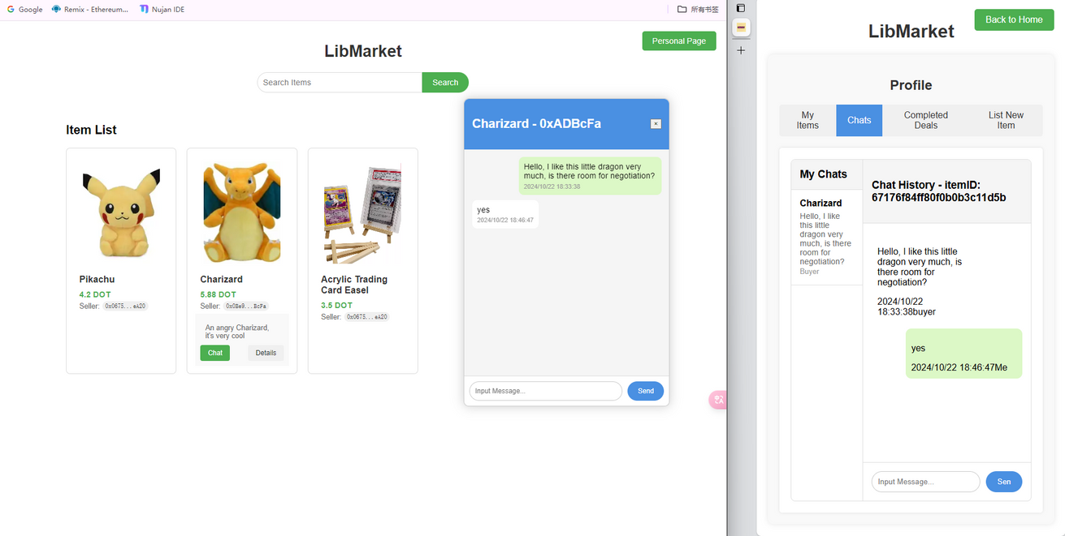




Function Realization
The buyer and seller can use instant communication to understand the product details and confirm the final price.
14

Slide 15

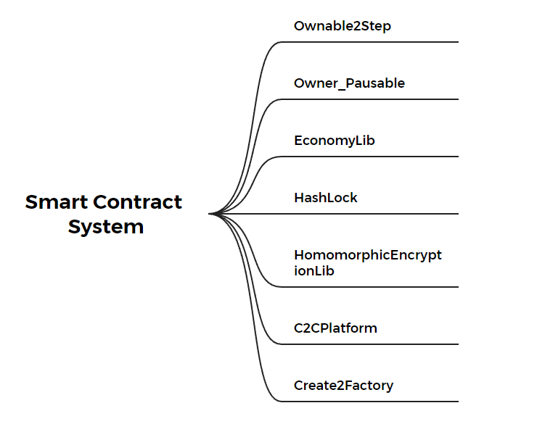

Smart Contract Architecture
https://moonbeam-explorer.netlify.app/tx/0xfe5bab25bf7db3f5b5d7f7db89a6536d93f0d58d274f27384f62b85e156bb3fb?network=MoonbaseAlpha
Moonbeam
CSEE
We divide the contract into blocks:
Moonbeam provides an EVM-compatible Layer 1 parachain for deploying our main contracts.
At the same time, we use CESS as data storage dependency and zk-proof calculation. CESS provides the best solution for storing and retrieving high-frequency dynamic data, facilitating information interaction between LibMarket users and rapid response to listing items.
15

Slide 16
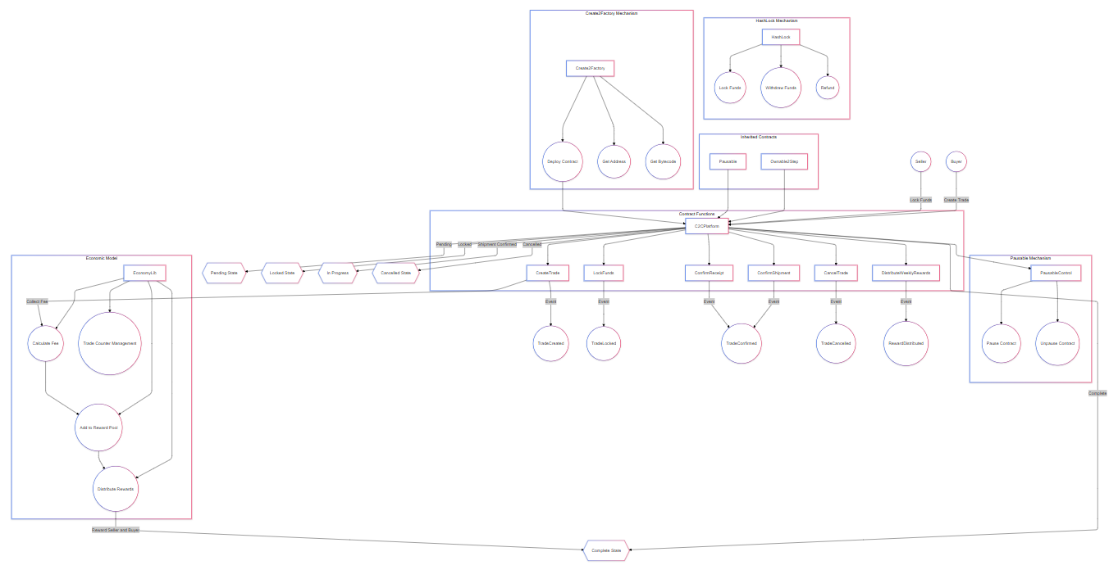
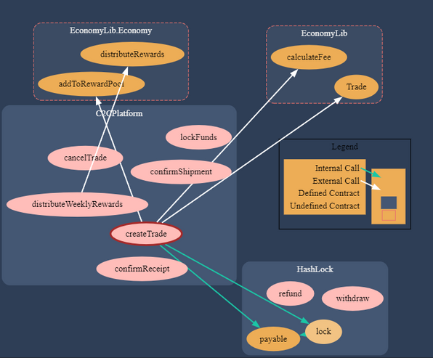
Smart contract full architecture
16

Slide 17
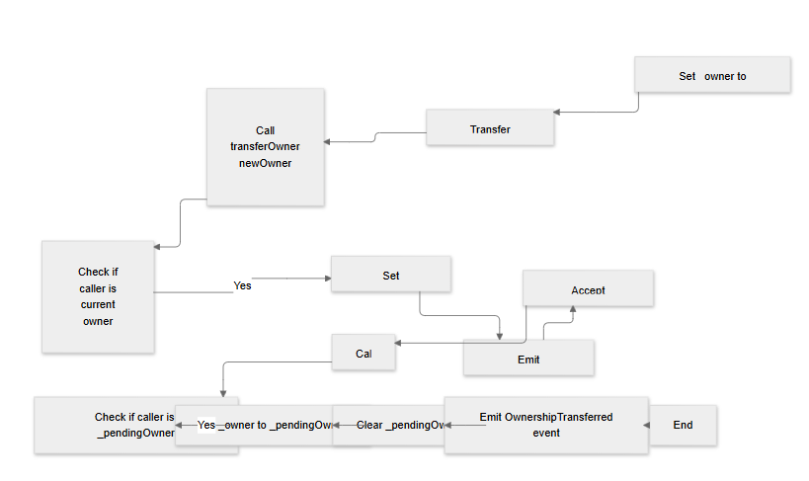
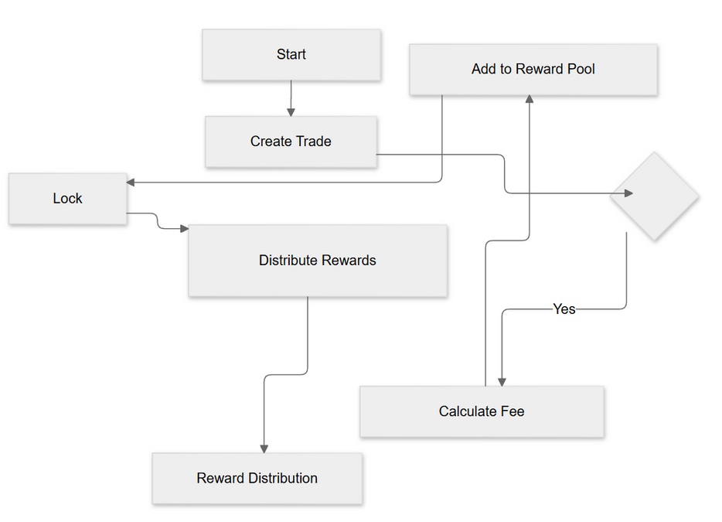
Portability Contracts and Economic Token Model
EconomyLib is a library for managing trading economic models, including fee calculation, reward pool management, and trading state definition.
We use Ownable2Step to provide a secure ownership management and transfer mechanism for subsequent owner updates, ensuring that the management rights of the contract will not be easily abused.
Pausable allows the contract to suspend operations when necessary, thereby enhancing security and protecting users and contract assets. By combining these two contracts, a flexible and secure contract management system can be implemented.
17

Slide 18
05
Privacy and Security Protection
18

Slide 19
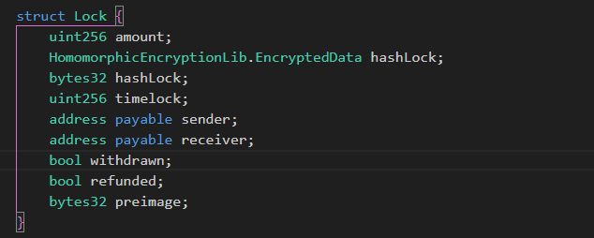
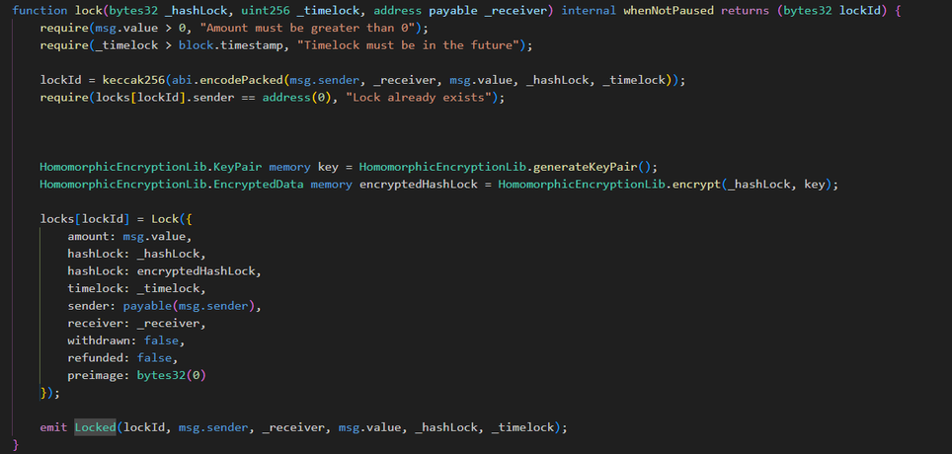
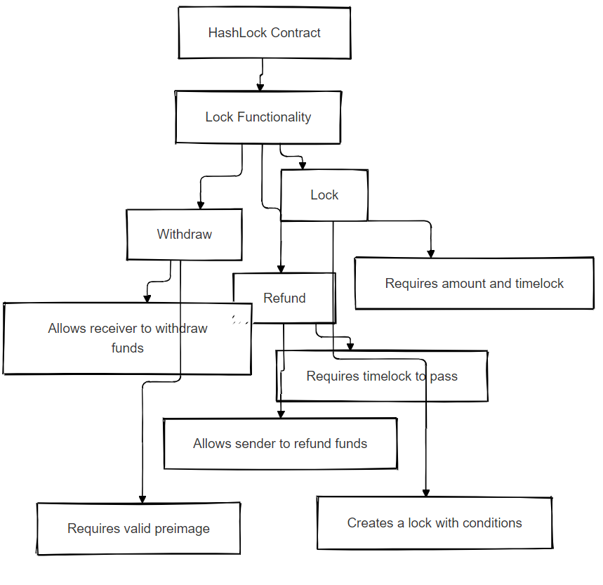
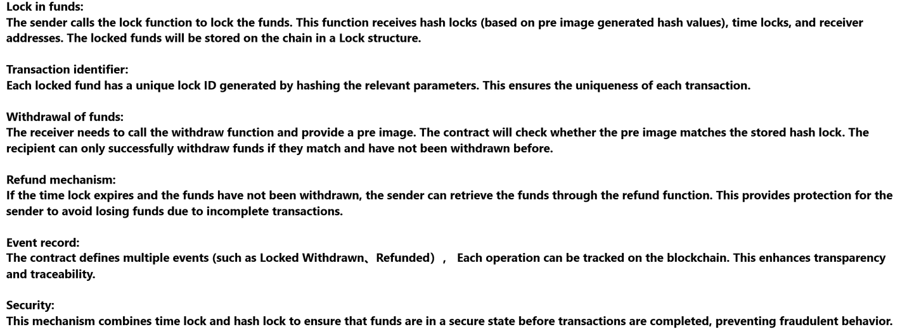
HashLock mechanism
19

Slide 20
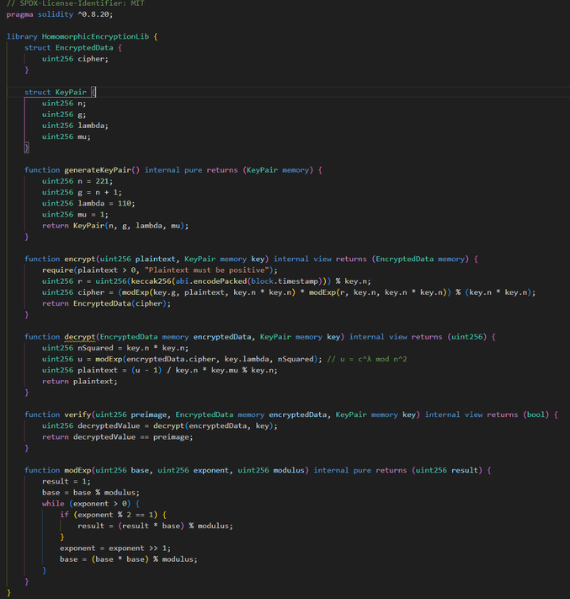
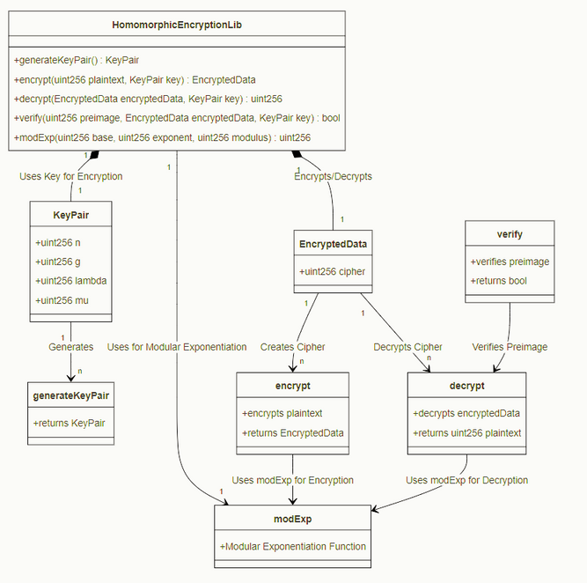
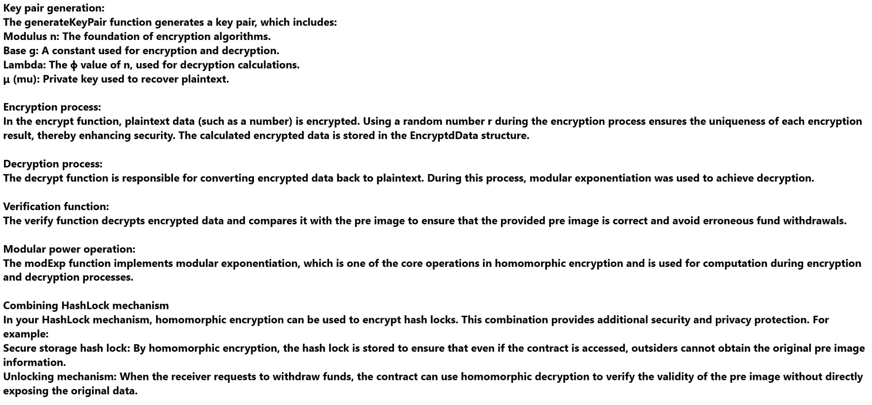
Architecture Diagram
ZK Homomorphic Encryption
Code Block
20

Slide 21
06
Future plans
21

Slide 22
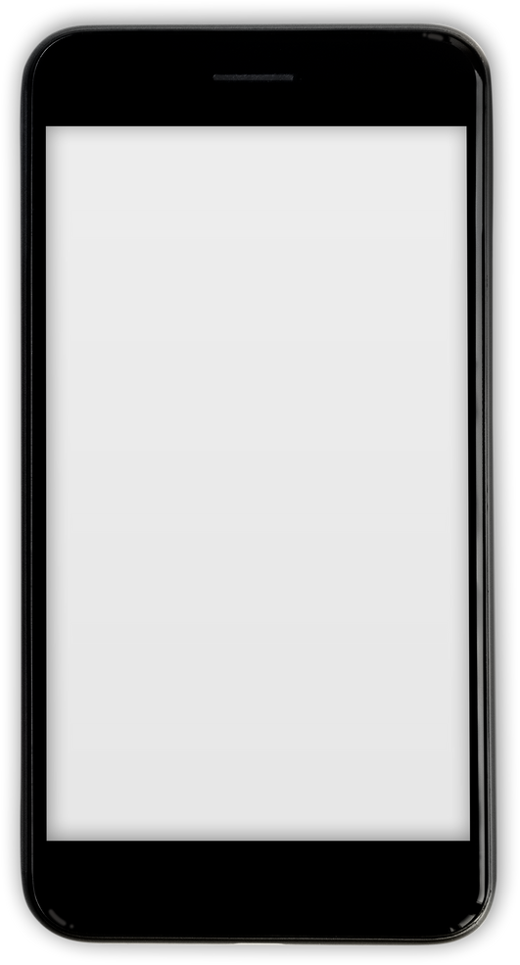


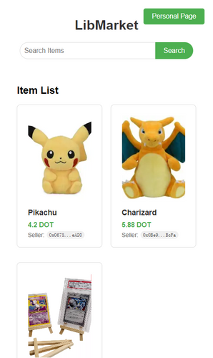



Mobile Application Development
We will adopt a mobile-first design to ensure that the application is mobile-centric, optimize the user interface and interaction, and provide a high-quality experience.
At the same time, we will implement real-time transactions, price updates and notifications through mobile applications, understand the status of points, and let users keep abreast of market trends.
And connect to telegram as a miniWeb so that all users can use it easily!
22

Slide 23
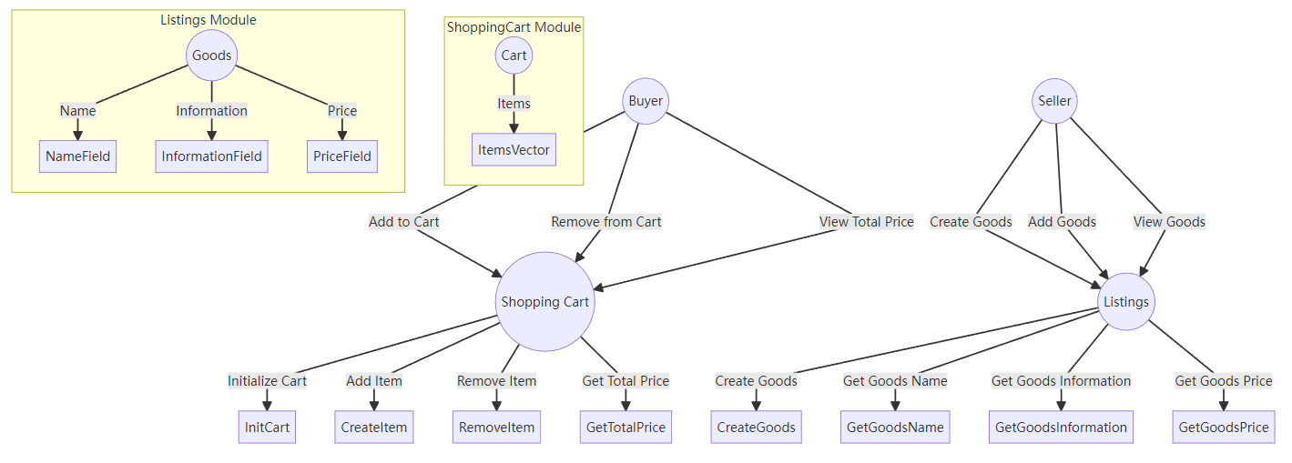

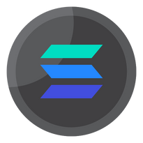
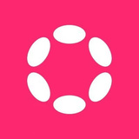

Multi-Ecosystem Interaction Expansion
In the future, we will also introduce multiple ecosystems to support trading with various currencies. At that time, you will be able to convert the cryptocurrencies you hold into the desired cryptocurrencies on our platform. This initiative will significantly expand our user base and enhance the user experience.
We have reserved interfaces so that in the future, we can connect the contract codes of other ecosystems through Polkadot. For example, sui can be used to implement shopping carts, lists and other functions. Other projects can call these interfaces, and contracts of other ecosystems can be used in the Polkadot ecosystem, expanding its coverage.

Slide 24
Project Vision
In this rapidly evolving digital age, traditional e-commerce models can no longer meet our growing needs, as the information requirements for registering on platforms lead to privacy breaches. We believe everyone should have a secure, transparent, and fair trading environment; this is not only about buying and selling goods but also about building trust and community. A decentralized e-commerce platform only requires a wallet address.
We are committed to breaking down the barriers of traditional commerce, allowing everyone to trade freely here. Many traditional platforms cannot serve global users due to geographical restrictions. For example, in China, many people find it very difficult to pay on well-known platforms like Amazon. Our platform dismantles these barriers, enabling anyone, regardless of location, to easily engage in global transactions, connecting buyers and sellers and promoting the globalization of commerce.
True commerce is not isolated transactions; it is about connections between people. We aim to create a community where sellers and buyers can communicate, collaborate, and jointly drive innovation and development in business. Whether you are a small creator or a consumer seeking personalized products, you will find your space on our platform.
On our future journey, we will continuously listen to the voices of the community and optimize the platform's functions and experiences. Our goal is not only to create a trading market but also to establish a vibrant ecosystem where every user can find value and a sense of belonging.
Let us reshape e-commerce together, creating a boundary-less trading environment and enjoying the convenience of global transactions.
24

Slide 25
07
About Us
25

Slide 26











Our Team
S7iter
Azhan
PM&Web3sec, Full stack dev
CD&Web3sec, backend dev
Ch1hiro
LittleNewbie
UPON
Backend Dev&
Security Researcher
Front Dev
Cryptography and Market research
26

Slide 27
Decentralized Open Free Trade Platform
27

